Slide 1
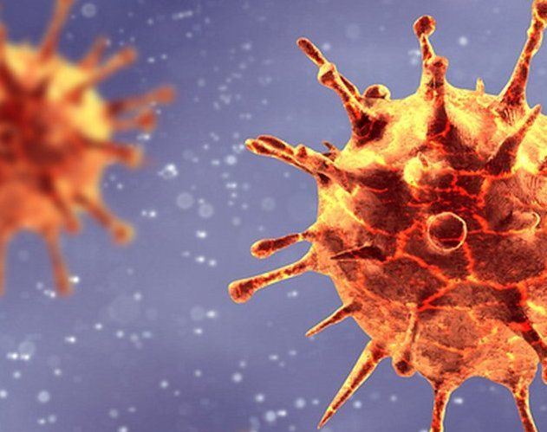
COVID-19 Freedom- a violated right during a world pandemic
Al Kinani Hawraa, Karanfilova Ljubica, Najafi Parnian

Slide 2
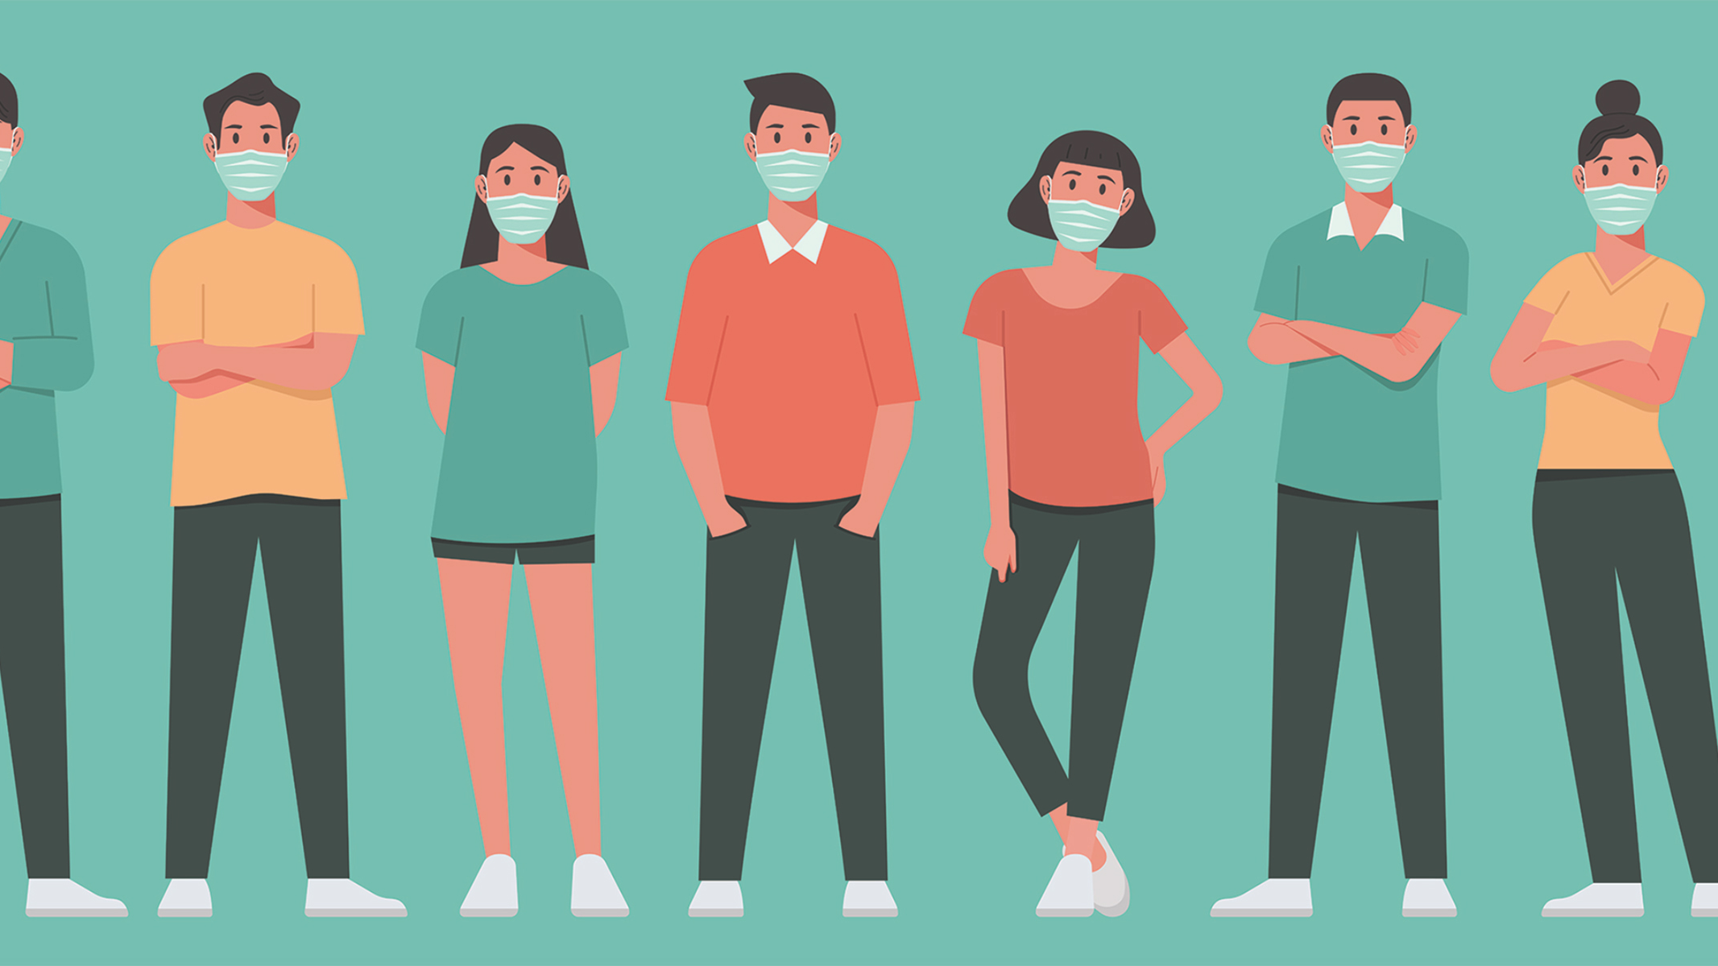
Who is affected the most?
Every generation
Especially young people/teenagers

Slide 3
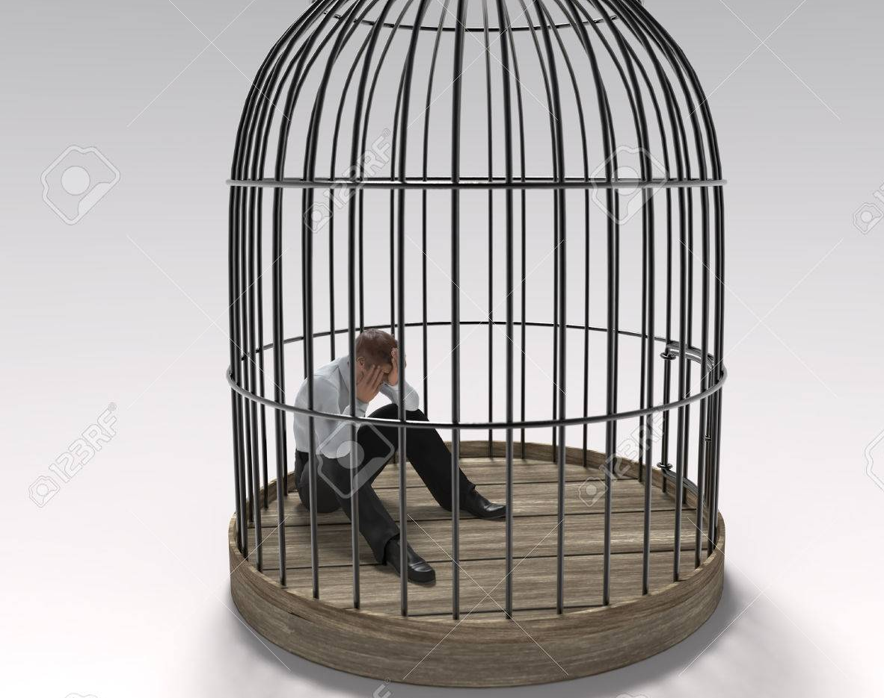
Losing freedom
no hanging out with friends/no fun
no school
no travelling
no walks
no outside dinners
no physical greetings
no family meetings

Slide 4
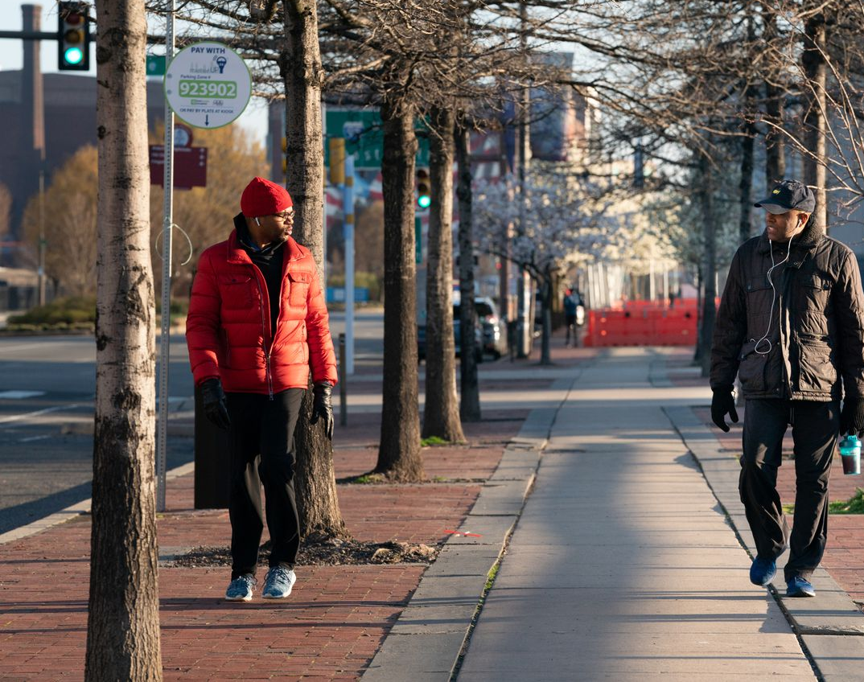
The new „(un)normals“
2 metres distance
masks
Desinfaction
Sneezing/coughing
Border crossing forbidden
Intermittent lockdowns

Slide 5
Safe travelling
A viral test 1-3 days before your trip
Wear a mask
Avoid crowds and keep distance
Get tested 3-5 days after your trip
Follow local recommendation

Slide 7
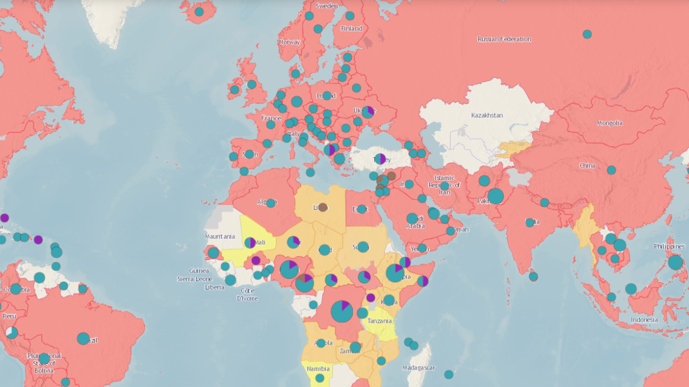
COVID-19
Since November 17, 2019
For more than one year
Vaccine
250 million people have been infected worldwide
1.75 million dead
Future?
https://www.worldometers.info/coronavirus/country/austria/

Slide 8
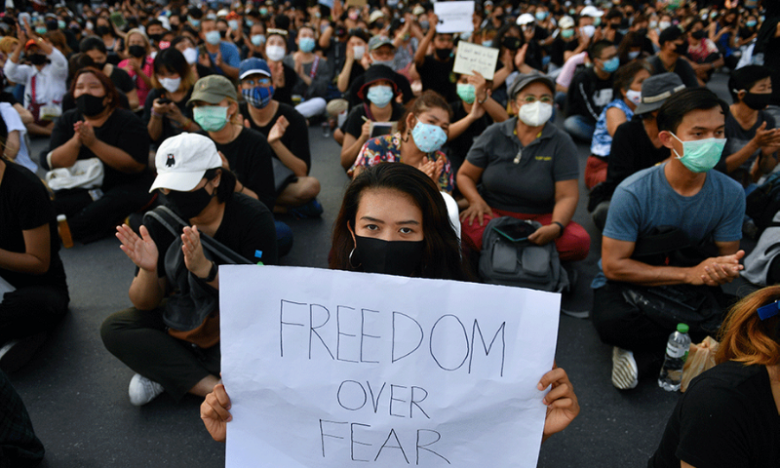
demonstrations
Against coronavirus

Slide 9
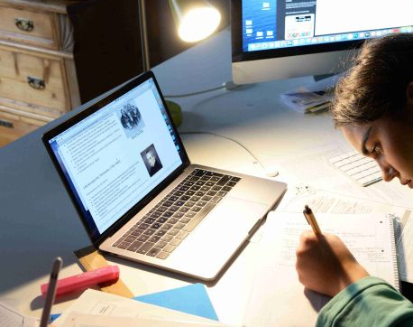
education
No school
Homeschooling
Knowledge worse
Pressure
-> health and mental health issues

Slide 10
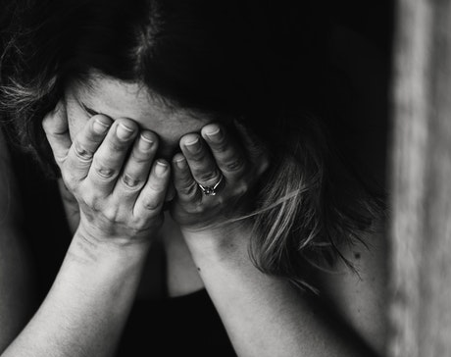
Health and mental health
Anxiety
Self-harm
Panic attacks
No motivation
No hope for future
Suicide
June 2020 more than 40% mental health issues

Slide 11
Healthy Ways to Cope with Stress
deep breaths, stretch or meditation
Eat healthy
Exercise regularly
Enough sleep
No alcohol, tobacco
Connect with others (talk to someone)

